Slide 1

DD310M
Assignment 1
Shubham Khare
180104072

Slide 2
Question 1. Choose any 4 products and mention the pros and cons of the product in terms of its aesthetics, function, form, ergonomics, and material. (Look for products around you).

Slide 3
OVERVIEW
All of us are surrounded by so many products, that make our lives much easier. But as we know no human is perfect similarly no product is perfect.
Still there are many advantages of these products, the reason being which we use them.
Let’s see 4 of those common products and their pros and cons.

Slide 4


Chalkboard

Slide 5
Pros
Cons
Economical
Intuitive in learning
Does not depend on any power source.
No additional preparation required for usage.
Can be used by anyone, of any age group.
Text written is temporary.
Dust of chalk may cause respiratory problems for users.
Several users may face height issues.
Time consuming

Slide 6
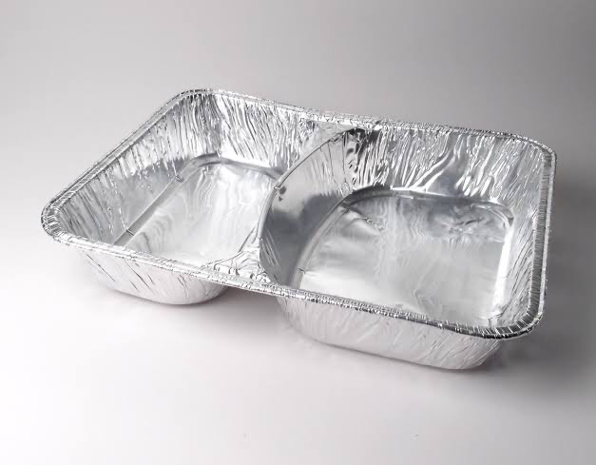
Aluminium Packaging

Slide 7
Cons
Pros
Cost Effective
Versatile
Keeps food warm for a sufficient duration
Hazardous
Easily torn when folded
Cannot be used for air tight packaging

Slide 8
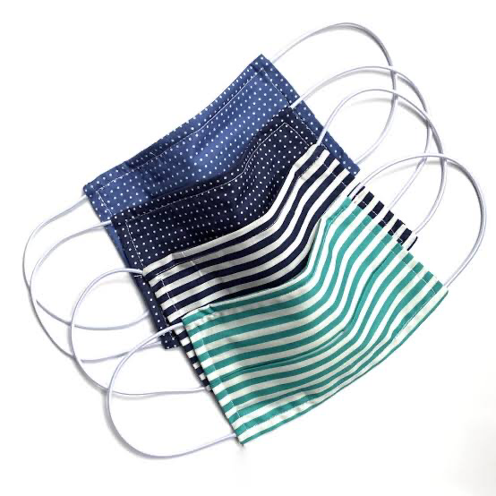
Face Mask

Slide 9
Pros
Cons
Protects from pathogens
Prevent transmission of air borne diseases
Restricts entrance of pollutants from air
Cheap
Continuous usage might cause skin problems due to moist conditions
Improper ventilation causes visual problem for people using specs

Slide 10

GRAMMARLY
Auto Correct based product apps

Slide 11
Pros
Cons
Useful for dyslexic people.
Makes text more presentable.
Easy to use.
Detects only common mistakes.
Spelling and grammatical mistakes are made more by users dependent on these applications.
Affects creativity in writing.

